Slide 1
What
Is the Emoticon?

Slide 2
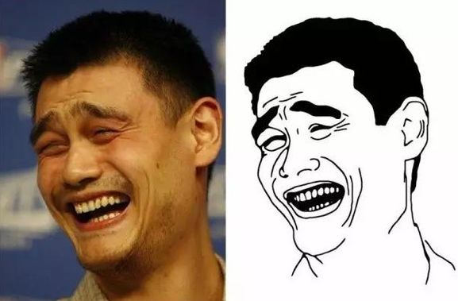

Slide 3
Where
Are there emoticon’s prototypes from?

Slide 5
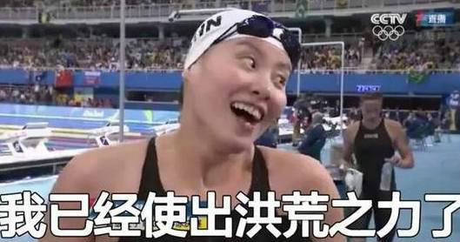

Slide 6
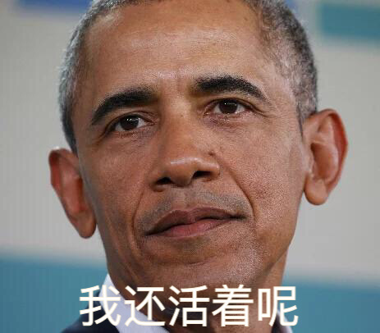

Slide 7
Who
Contributed these emoticons?

Slide 9
How
To use these Emoticons to

Slide 10
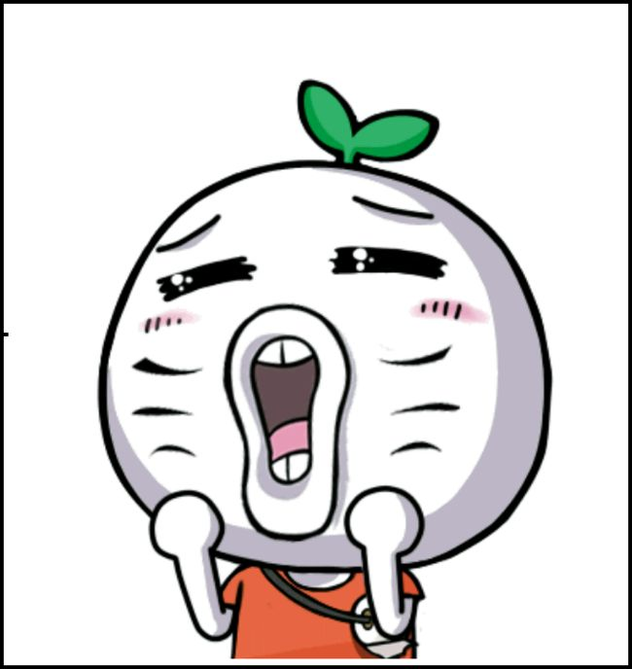
1. Entertainment
2. Tourism
3. Chat

Slide 11
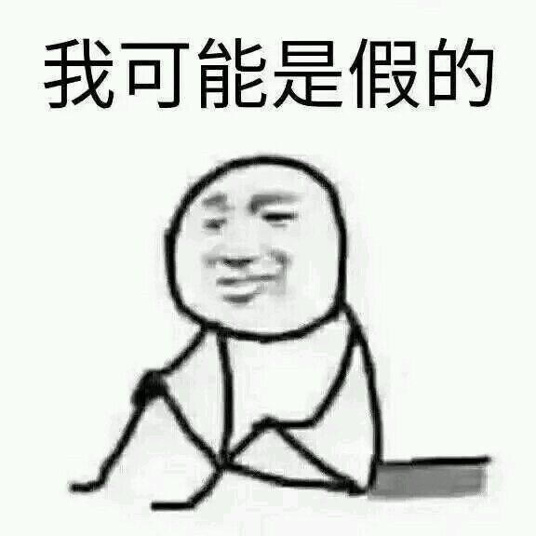
Probably I learnt the FAKE English!

